Slide 1
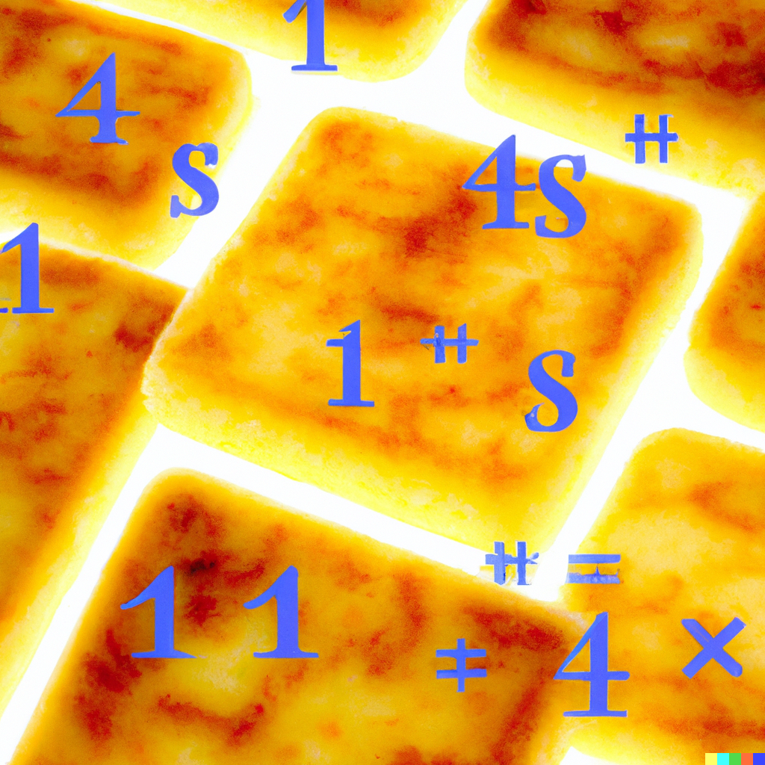
Hash Tables II
Lecture 20
CS61B, Spring 2024 @ UC Berkeley
Slides Credit: Josh Hug

Slide 2
Visualization for Some Basic Cases
Visualization for Some Basic Cases
hashCode and Equals
Why Custom Hash Functions?
contains
Duplicate Values
The Danger of Mutable Keys
Mutable vs. Immutable Types
Mutable Hash Table Keys
A Peek into Java HashSets
Lecture 20, CS61B, Spring 2024

Slide 3
Sets and Maps
We’ve now seen the two implementation philosophies for Sets and Maps.
Red black tree based approach: TreeSet/TreeMap.
Requires items to be comparable.
Logarithmic time operations.
Hash table based approach: HashSet/HashMap.
Constant time operations if the hashCode spreads the items out nicely.
Set
Map
HashSet
TreeSet
HashMap
TreeMap

Slide 4
Hash Tables in Java: Recap
Hash tables:
Data is converted into a hash code, the hash code is then reduced to a valid index.
Data is then stored in a bucket corresponding to that index.
Each bucket is a “separate chain” of items.
Resize when load factor N/M exceeds some constant.
If items are spread out nicely, you get Θ(1) average runtime.
Hash based set ops
 | contains(x) | add(x)
Bushy BSTs | Θ(log N) | Θ(log N)
Separate Chaining Hash Table With No Resizing | Θ(N) | Θ(N)
… With Resizing | Θ(1)† | Θ(1)*†
data
hash function
hash code
đậu hũ
hashCode()
-2108180664
Math.floorMod(x, 4)
0
reduce
index
*: Indicates “on average”.
†: Assuming items are evenly spread.

Slide 5
HashTableVisualizer
Let’s play around with a hash table visualizer.
Goal, get a deeper understanding of:
How hash codes affect the distribution of items.
The interaction between equals and hashCode.
Why hash tables are fast even though they use linked lists.

Slide 6
ColoredNumbers
The objects we’re inserting into the HashTable are of type ColoredNumber. Each has 2 attributes:
Let’s see what happens when we insert ColoredNumbers 0 through 19 into a hash table with 6 buckets.
private int num;
private Color color;

Slide 7
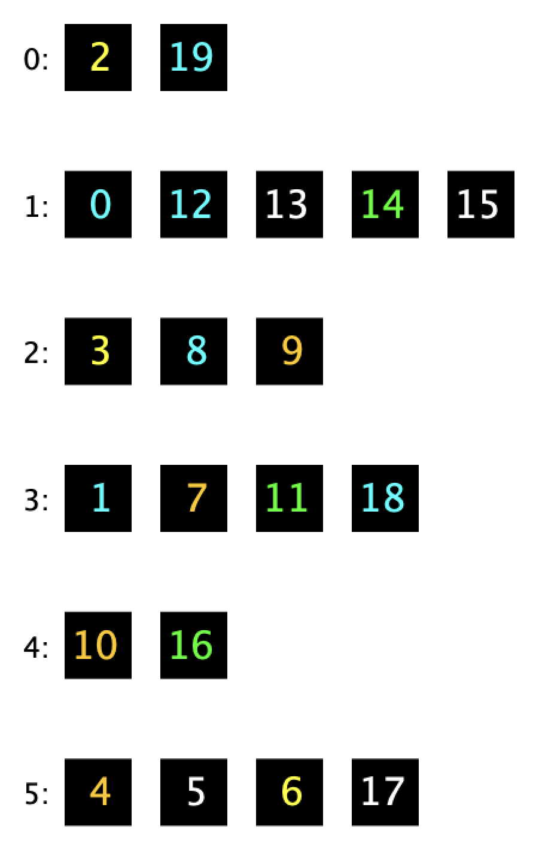
Distribution of Items
What do you notice about the distribution of items?
Why do you we get this distribution?

Slide 8
Distribution of Items (Your Answer)
What do you notice about the distribution of items?
No bin has more than 5 items
Odd indexes seem to have more items
Hash doesn't seem to correspond well with the item
Why do you think we get this distribution?
Average bin length is N/M
No clear pattern, nondeterministic (across runs)

Slide 9
Creating a Custom hashCode Function
Suppose we create a hashCode function that returns 0.
What distribution do we expect?
In other words, how will the figure to the right change?
Let’s try it out.
@Override
public int hashCode() {
return 0;
}

Slide 10
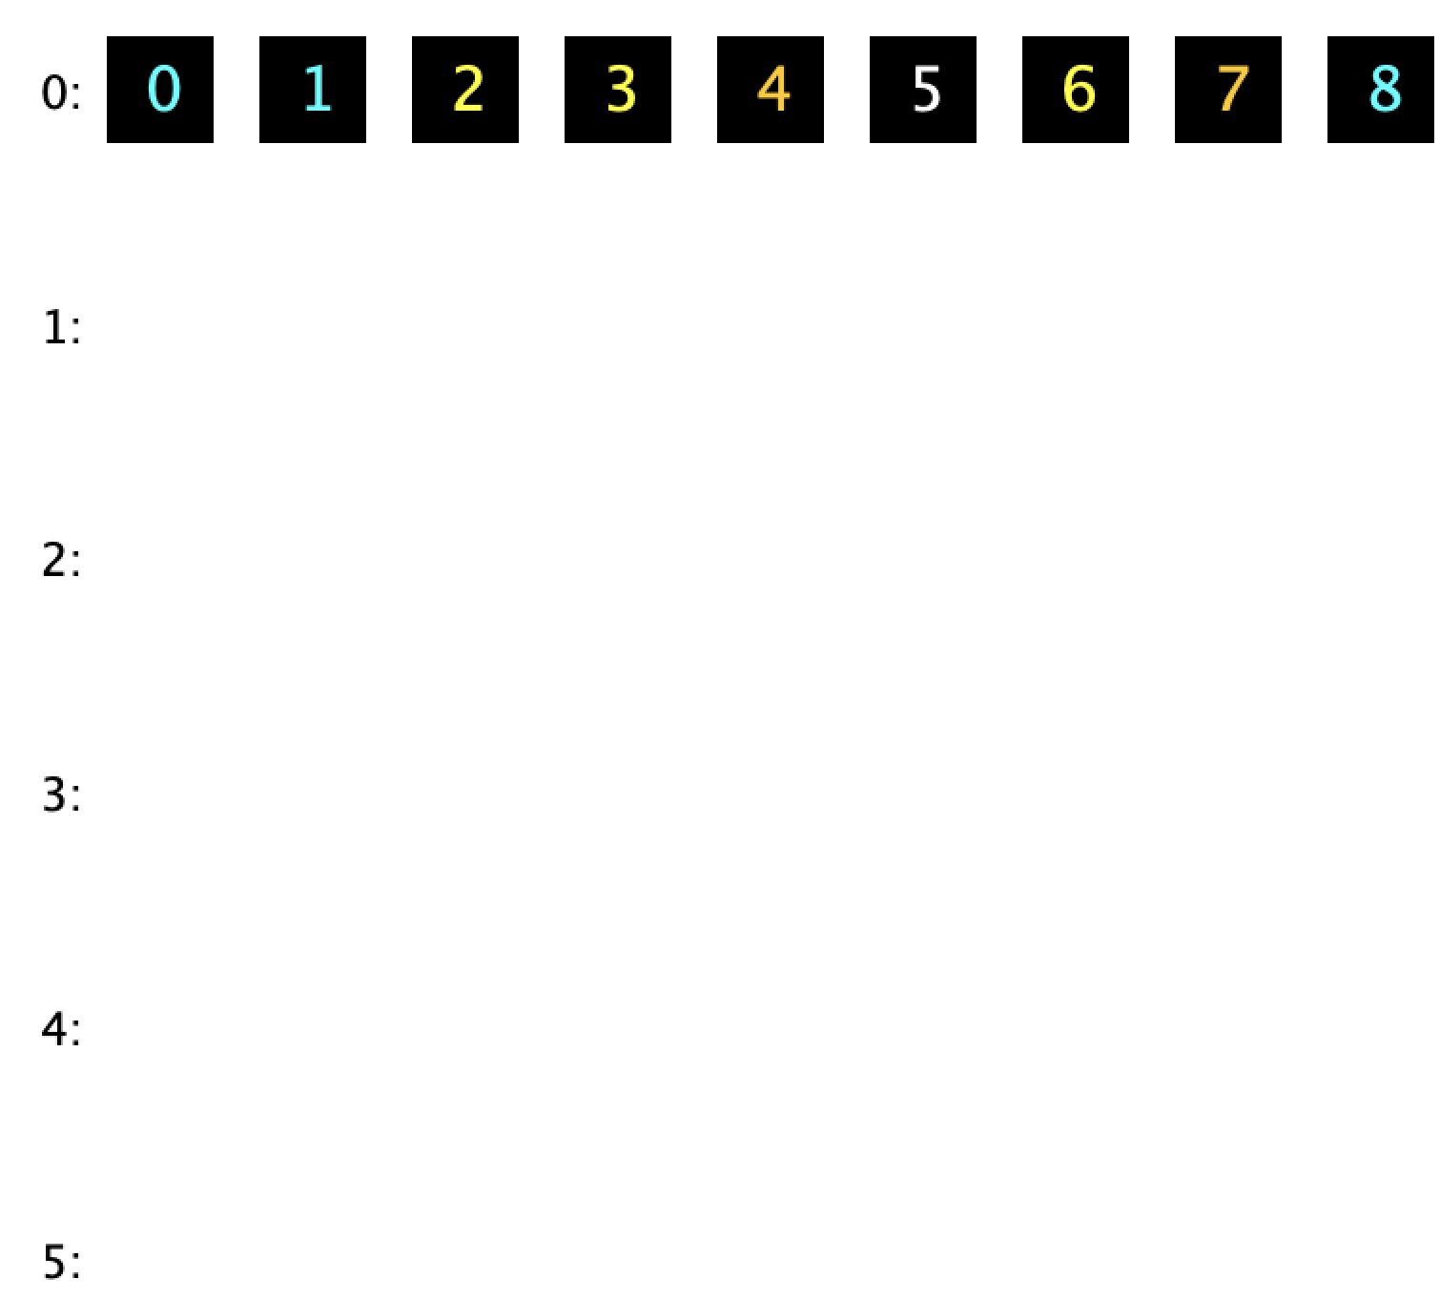
The Zero HashCode Function
The resulting distribution is to the right.

Slide 11
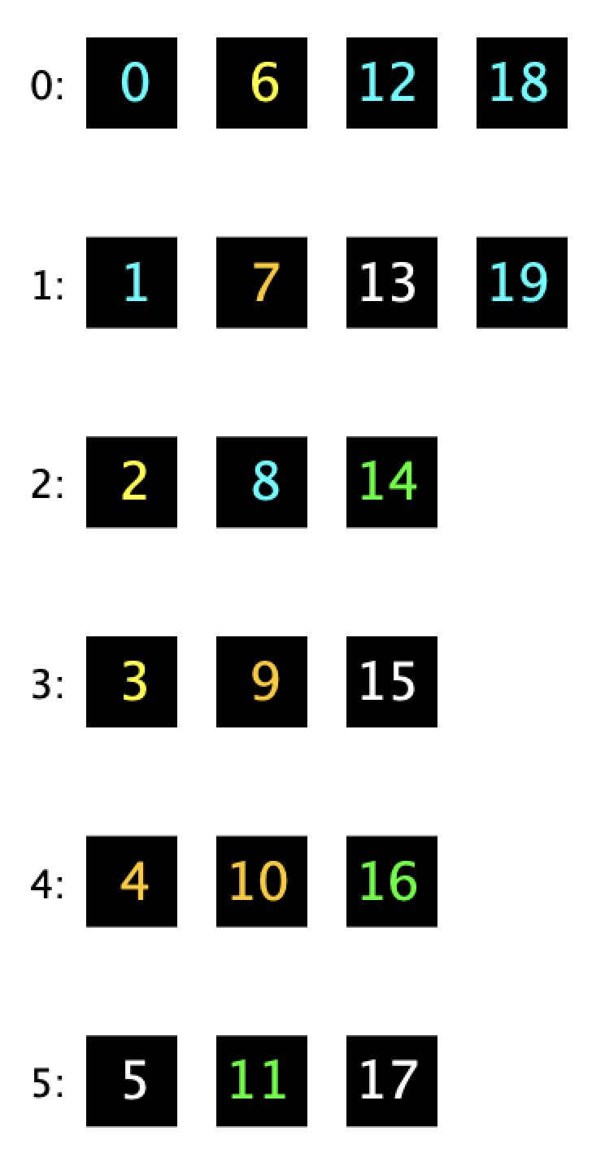
Designing a Hash Function
What hash function will result in the distribution to the right?
private int num;
private Color color;

Slide 12
Designing a Hash Function
What hash function will result in the distribution to the right?
Your answer?
num % 6
Let’s check it.
private int num;
private Color color;

Slide 13
Other More Exotic Hash Functions
We can define whatever hash function we want:
Leading digit.
Sum of the digits.
Length of the number.
Something else?
Let’s try one. Which one do you want to try?

Slide 14
Why Custom Hash Functions?
Visualization for Some Basic Cases
hashCode and Equals
Why Custom Hash Functions?
contains
Duplicate Values
The Danger of Mutable Keys
Mutable vs. Immutable Types
Mutable Hash Table Keys
A Peek into Java HashSets
Lecture 20, CS61B, Spring 2024
Notes:
rr

Slide 15
HashCode Comparison
We mentioned that the goal of a hash function is to try to spread items out evenly.
No spread: Returning 0.
Bad spread: Returning sum of the digits.
Good spread: Returning num.

Slide 16
The Default hashCode: yellkey.com/part
We mentioned that the goal of a hash function is to try to spread items out evenly.
No spread: Returning 0.
Bad spread: Returning sum of the digits.
Good spread: Returning num.
What do you think about the spread of the default hashCode, which returns the memory address?
No spread.
Bad spread.
Good spread.

Slide 17
The Default hashCode
We mentioned that the goal of a hash function is to try to spread items out evenly.
No spread: Returning 0.
Bad spread: Returning sum of the digits.
Good spread: Returning num.
What do you think about the spread of the default hashCode, which returns the memory address?
No spread.
Bad spread.
Good spread: The memory address is effectively random, so items should be evenly distributed.

Slide 18
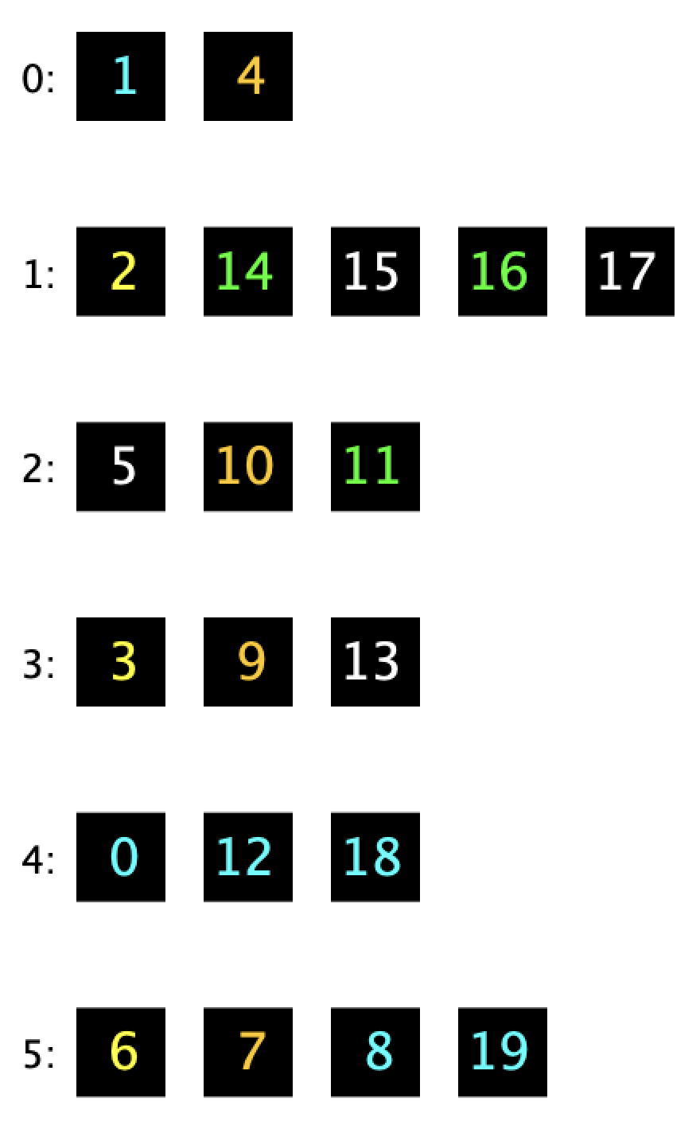
Hard Question
If the default hashCode achieves good spread, why do we even bother to create custom hash functions?

Slide 19
contains
Visualization for Some Basic Cases
hashCode and Equals
Why Custom Hash Functions?
contains
Duplicate Values
The Danger of Mutable Keys
Mutable vs. Immutable Types
Mutable Hash Table Keys
A Peek into Java HashSets
Lecture 20, CS61B, Spring 2024
Notes:
rr

Slide 20
The equals Method for a ColoredNumber
Suppose the equals method for ColoredNumber is as below, i.e. two ColoredNumbers are equal if they have the same num.
General principle: if two things are equal, they should act as if they are the same thing to outside observers
@Override
public boolean equals(Object o) {
if (o instanceof ColoredNumber otherCn) {
return this.num == otherCn.num;
}
return false;
}

Slide 21
HashSet Behavior
Suppose the equals method for ColoredNumber is on the previous slide, i.e. two ColoredNumbers are equal if they have the same num.
Suppose we now check whether 12 is in the hash table.
What do we expect to be returned by contains?
int N = 20;
HashSet<ColoredNumber> hs = new HashSet<>();
for (int i = 0; i < N; i += 1) {
hs.add(new ColoredNumber(i));
}
ColoredNumber twelve = new ColoredNumber(12);
hs.contains(twelve); // returns ??

Slide 22
HashSet Behavior
Suppose the equals method for ColoredNumber is on the previous slide, i.e. two ColoredNumbers are equal if they have the same num.
Suppose we now check whether 12 is in the hash table.
What do we expect to be returned by contains?
We expect the contains call to be true, all 12s are created equal!
int N = 20;
HashSet<ColoredNumber> hs = new HashSet<>();
for (int i = 0; i < N; i += 1) {
hs.add(new ColoredNumber(i));
}
ColoredNumber twelve = new ColoredNumber(12);
hs.contains(twelve); // returns true

Slide 23
Finding an Item Using the Default HashCode
Suppose we are using the default hash function (uses memory address), which yields the table to the right.
Suppose equals returns true if two ColoredNumbers have the same num (as on the previous slide).
What does the contains operation return. Why?
int N = 20;
HashSet<ColoredNumber> hs = new HashSet<>();
for (int i = 0; i < N; i += 1) {
hs.add(new ColoredNumber(i));
}
ColoredNumber twelve = new ColoredNumber(12);
hs.contains(twelve); // returns ??

Slide 24
Finding an Item Using the Default HashCode
Suppose we are using the default hash function (uses memory address), which yields the table to the right.
Suppose equals returns true if two ColoredNumbers have the same num (as on the previous slide).
What does the contains operation return. Why?
Returns false with probability 5/6ths.
int N = 20;
HashSet<ColoredNumber> hs = new HashSet<>();
for (int i = 0; i < N; i += 1) {
hs.add(new ColoredNumber(i));
}
ColoredNumber twelve = new ColoredNumber(12);
hs.contains(twelve); // returns ??

Slide 25
Finding an Item Using the Default HashCode
hashCode: Based on memory address.
equals: Based on num.
There are two ColoredNumber objects with num = 12.
One of them is in the HashSet.
One of them was created by the code above.
Each memory address is random.
Only 1/6th chance they % to the same bucket.
ColoredNumber twelve = new ColoredNumber(12);
hs.contains(twelve); // returns ??

Slide 26
Finding an Item Using the Default HashCode
hashCode: Based on memory address.
equals: Based on num.
There are two ColoredNumber objects with num = 12.
One of them is in the HashSet.
One of them was created by the code above.
Example: If object created by code above is in memory location 6000000, its hashCode % 6 is 0.
HashSet looks in bucket zero, doesn’t find 12.
ColoredNumber twelve = new ColoredNumber(12);
hs.contains(twelve); // returns ??

Slide 27
Hard Question
If the default hashCode achieves good spread, why do we even bother to create custom hash functions?
Necessary to have consistency between equals and hashCode for basic operations to function.
Basic rule: If two objects are equal, they’d better have the same hashCode so the hash table can find it.

Slide 28
Duplicate Values
Visualization for Some Basic Cases
hashCode and Equals
Why Custom Hash Functions?
contains
Duplicate Values
The Danger of Mutable Keys
Mutable vs. Immutable Types
Mutable Hash Table Keys
A Peek into Java HashSets
Lecture 20, CS61B, Spring 2024

Slide 29
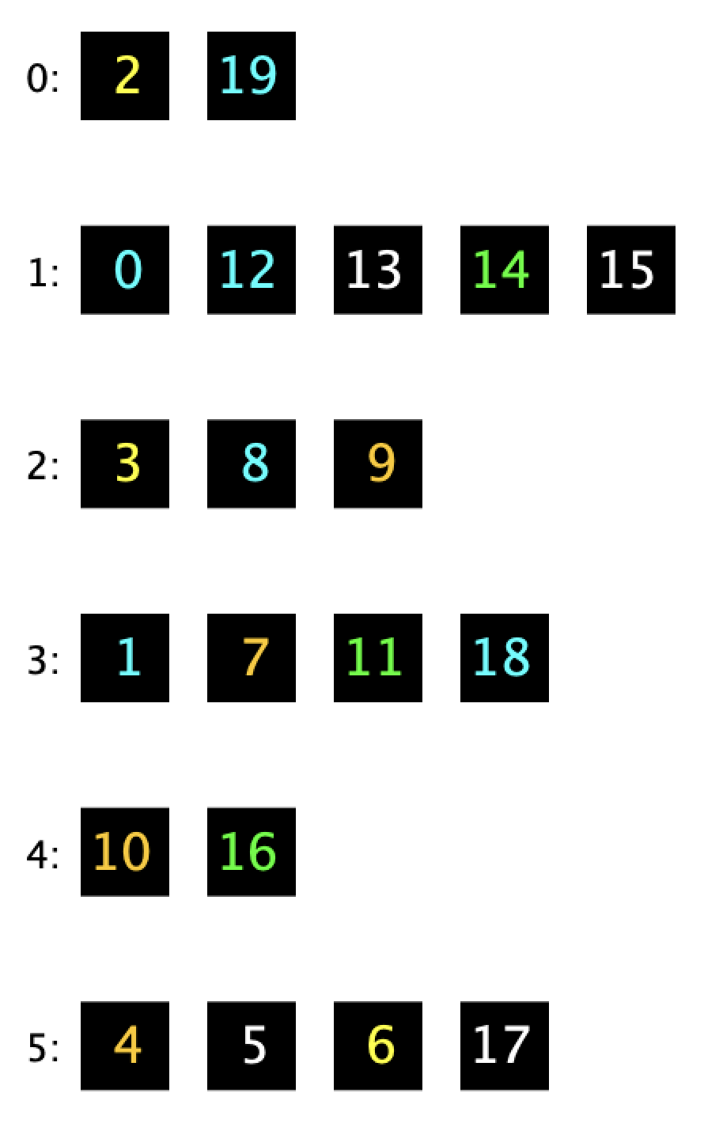
Overriding Equals but Not HashCode: yellkey.com/wide
Suppose we have the same equals method (comparing num), but we do not override hashCode.
Result of adding 0 through 19 is shown to the right.
Which can happen when we call add(zero)?
We add another 0 to bin zero.
We add another 0 to bin one.
We add another 0 to some other bin.
We do not get a duplicate zero.
public boolean equals(Object o) {
... return this.num == otherCn.num; ...
}
ColoredNumber zero = new ColoredNumber(0);
hs.add(zero); // does another zero appear?

Slide 30
Overriding Equals but Not HashCode
Suppose we have the following equals method, but we do not override hashCode.
Result of adding 0 through 19 is shown to the right.
Which of the following can happen if we add 0 again?
We add another 0 to bin zero.
We add another 0 to bin one.
We add another 0 to some other bin.
We do not get a duplicate zero.
@Override
public boolean equals(Object o) {
if (o instanceof ColoredNumber otherCn) {
return this.num == otherCn.num;
}
return false;
}

Slide 31
Overriding Equals but Not HashCode
Suppose we have the following equals method, but we do not override hashCode.
Result of adding 0 through 19 is shown to the right.
Which of the following can happen if we add 0 again?
The new zero ends up in a random bin.
5/6ths chance: In bin 0, 2, 3, 4, or 5. Duplicate!
1/6 chance: In bin 1, no duplicate! (equals blocks it)
@Override
public boolean equals(Object o) {
if (o instanceof ColoredNumber otherCn) {
return this.num == otherCn.num;
}
return false;
}

Slide 32
Takeaway: Equals and hashCode
Bottom line: If your class override equals, you should also override hashCode in a consistent manner.
If two objects are equals, they must always have the same hashCode.
If you don’t everything breaks:
Contains can’t find objects (unless it gets lucky).
Add results in duplicates.

Slide 33
Mutable vs. Immutable Types
Visualization for Some Basic Cases
hashCode and Equals
Why Custom Hash Functions?
contains
Duplicate Values
The Danger of Mutable Keys
Mutable vs. Immutable Types
Mutable Hash Table Keys
A Peek into Java HashSets
Lecture 20, CS61B, Spring 2024

Slide 34
Immutable Data Types
An immutable data type is one for which an instance cannot change in any observable way after instantiation.
Examples:
Mutable: ArrayDeque, Percolation.
Immutable: Integer, String, Date.
The final keyword will help the compiler ensure immutability.
final variable means you may assign a value once (either in constructor of class or in initializer), but after it can never change.
Final is neither sufficient nor necessary for a class to be immutable.
public class Date {
public final int month;
public final int day;
public final int year;
private boolean contrived = true;
public Date(int m, int d, int y) {
month = m; day = d; year = y;
}
}

Slide 35
Which of the Classes Below Are Immutable?
Immutable: an instance cannot change in any observable way after instantiation.
public class Pebble {
public int weight;
public Pebble() {
weight = 1;
}
}
public class Rock {
public final int weight;
public Rock (int w) {
weight = w;
}
}
public class RocksBox {
public final Rock[] rocks;
public RocksBox (Rock[] rox) {
rocks = rox;
}
}
public class SecretRocksBox {
private Rock[] rocks;
public SecretRocksBox(Rock[] rox) {
rocks = rox;
}
}

Slide 36
Which of the Classes Below Are Immutable?
Immutable: an instance cannot change in any observable way after instantiation.
public class Pebble {
public int weight;
public Pebble() {
weight = 1;
}
}
Example mutation:
Pebble p = new Pebble();
p.weight = 2;

Slide 37
Which of the Classes Below Are Immutable?
Immutable: an instance cannot change in any observable way after instantiation.
public class Rock {
public final int weight;
public Rock (int w) {
weight = w;
}
}
No mutation possible.
Unless you use the special “Reflections” library which lets you disobey access modifiers.

Slide 38
Which of the Classes Below Are Immutable?
Immutable: an instance cannot change in any observable way after instantiation.
Example mutation:
Rock r1 = new Rock(10);
Rock r2 = new Rock(20);
Rock[] rox = {r1, r2};
RocksBox rb = new RocksBox(rox);
rb.rocks[1] = null;
public class RocksBox {
public final Rock[] rocks;
public RocksBox (Rock[] rox) {
rocks = rox;
}
}

Slide 39
Which of the Classes Below Are Immutable?
Immutable: an instance cannot change in any observable way after instantiation.
Example mutation:
Rock r1 = new Rock(10);
Rock r2 = new Rock(20);
Rock[] rox = {r1, r2};
SecretRocksBox rb = new SecretRocksBox(rox);
rox[0] = new Rock(-999);
public class SecretRocksBox {
private Rock[] rocks;
public SecretRocksBox(Rock[] rox) {
rocks = rox;
}
}

Slide 40
Which of the Classes Below Are Immutable?
Immutable: an instance cannot change in any observable way after instantiation.
public class Pebble {
public int weight;
public Pebble() {
weight = 1;
}
}
public class Rock {
public final int weight;
public Rock (int w) {
weight = w;
}
}
public class RocksBox {
public final Rock[] rocks;
public RocksBox (Rock[] rox) {
rocks = rox;
}
}
public class SecretRocksBox {
private Rock[] rocks;
public SecretRocksBox(Rock[] rox) {
rocks = rox;
}
}

Slide 41
How Would We Make SecretRocksBox Immutable?
Immutable: an instance cannot change in any observable way after instantiation.
Example mutation:
Rock r1 = new Rock(10);
Rock r2 = new Rock(20);
Rock[] rox = {r1, r2};
SecretRocksBox rb = new SecretRocksBox(rox);
rox[0] = new Rock(-999);
public class SecretRocksBox {
private Rock[] rocks;
public SecretRocksBox(Rock[] rox) {
rocks = rox;
}
}

Slide 42
How Would We Make SecretRocksBox Immutable?
To make SecretRocksBox immutable, we can make our own copy of the array.
Example mutation fails!
Rock r1 = new Rock(10);
Rock r2 = new Rock(20);
Rock[] rox = {r1, r2};
SecretRocksBox rb = new SecretRocksBox(rox);
rox[0] = new Rock(-999);
public class SecretRocks {
private Rock[] rocks;
public SecretRocks(Rock[] rox) {
rocks = new Rock[rox.length];
System.arraycopy(rox, 0,
rocks, 0,
rox.length);
}
}

Slide 43
Immutability
Advantage: Less to think about: Avoids bugs and makes debugging easier.
Analogy: Immutable classes have some buttons you can press / windows you can look inside. Results are ALWAYS the same, no matter what.
Disadvantage: Must create a new object anytime anything changes.
Example: String concatenation is slow!
charAt(int i)
compareTo(String s)
concat(String s)
split(String r)
String

Slide 44
Mutable Hash Table Keys
Visualization for Some Basic Cases
hashCode and Equals
Why Custom Hash Functions?
contains
Duplicate Values
The Danger of Mutable Keys
Mutable vs. Immutable Types
Mutable Hash Table Keys
A Peek into Java HashSets
Lecture 20, CS61B, Spring 2024

Slide 45
Mutable HashSet Keys
In principle, we can create a HashSet<List>.
Weird stuff happens if:
We insert a List into a HashSet.
Later mutate that List.

Slide 46
Example: hashCode
Consider an ArrayList equal to [0, 1].
Such a list has hashCode 962 (can compute using code shown).
List<Integer> items = new ArrayList<>();
items.add(0);
items.add(1);
System.out.println(items.hashCode());

Slide 47
Example
Consider an ArrayList equal to [0, 1].
Such a list has hashCode 962 (can compute using code shown).
If we add this list to a HashSet with 4 buckets, it lands in bucket 2 (962 % 4 = 2).
0
1
2
3
[0, 1]
List<Integer> items = new ArrayList<>();
items.add(0);
items.add(1);
System.out.println(items.hashCode());
HashSet<List<Integer>> hs = new HashSet<>();
hs.add(items);

Slide 48
Example
First, we added [0, 1], which had hashCode 962, and landed in bucket 2.
Suppose we now add the list [2, 3]. This list has hashCode 1026, which also lands in bucket 2.
0
1
2
3
[2, 3]
[0, 1]
List<Integer> items = new ArrayList<>();
items.add(0);
items.add(1);
HashSet<List<Integer>> hs = new HashSet<>();
hs.add(items);
hs.add(List.of(2, 3));

Slide 49
Example
Suppose we add [0, 1], then [2, 3].
Now suppose we add the number 7 to items.
0
1
2
3
[2, 3]
[0, 1, 7]
List<Integer> items = new ArrayList<>();
items.add(0);
items.add(1);
HashSet<List<Integer>> hs = new HashSet<>();
hs.add(items);
hs.add(List.of(2, 3));
items.add(7);

Slide 50
Example
Suppose we add [0, 1], then [2, 3].
Now suppose we add the number 7 to items.
The hashCode of a list with [0, 1, 7] is 29829.
What could go wrong?
What method call will fail?
0
1
2
3
[2, 3]
[0, 1, 7]
List<Integer> items = new ArrayList<>();
items.add(0);
items.add(1);
HashSet<List<Integer>> hs = new HashSet<>();
hs.add(items);
hs.add(List.of(2, 3));
items.add(7);

Slide 51
Example
Suppose we add [0, 1], then [2, 3].
Now suppose we add the number 7 to items.
The hashCode of a list with [0, 1, 7] is 29829.
What could go wrong?
What method call will fail?
contains(items)
0
1
2
3
[2, 3]
[0, 1, 7]
List<Integer> items = new ArrayList<>();
items.add(0);
items.add(1);
HashSet<List<Integer>> hs = new HashSet<>();
hs.add(items);
hs.add(List.of(2, 3));
items.add(7);
System.out.println(hs.contains(items));

Slide 52
Example
Suppose we add [0, 1], then [2, 3].
Now suppose we add the number 7 to items.
The hashCode of a list with [0, 1, 7] is 29829.
If we call contains(items), we have a problem.
hashCode of items is 29829 % 4 = 1.
Hash table looks in bucket 1, empty!
0
1
2
3
[2, 3]
[0, 1, 7]
List<Integer> items = new ArrayList<>();
items.add(0);
items.add(1);
HashSet<List<Integer>> hs = new HashSet<>();
hs.add(items);
hs.add(List.of(2, 3));
items.add(7);
System.out.println(hs.contains(items));

Slide 53
Don’t Mutate Keys
Bottom line: Never mutate an Object being used as a key.
Incorrect results, item gets lost.
0
1
2
3
[2, 3]
[0, 1, 7]
List<Integer> items = new ArrayList<>();
items.add(0);
items.add(1);
HashSet<List<Integer>> hs = new HashSet<>();
hs.add(items);
hs.add(List.of(2, 3));
items.add(7);
System.out.println(hs.contains(items));

Slide 54
A Peek into Java HashSets
Visualization for Some Basic Cases
hashCode and Equals
Why Custom Hash Functions?
contains
Duplicate Values
The Danger of Mutable Keys
Mutable vs. Immutable Types
Mutable Hash Table Keys
A Peek into Java HashSets
Lecture 20, CS61B, Spring 2024

Slide 55
HashSets in Java
We can look at the code that implements the HashSet in Java:
https://github.com/openjdk/jdk/blob/master/src/java.base/share/classes/java/util/HashSet.java
It simply delegates all of its work to a HashMap<K, Object> and ignores the value.

Slide 56
HashSets in Java
We can then look at the code that implements the HashMap in Java:
https://github.com/openjdk/jdk/blob/master/src/java.base/share/classes/java/util/HashMap.java
Reading the code, we can see that:
Hash table starts at size 16, then doubles every time N exceeds load factor which defaults to 0.75.
The reduce function is a bit complicated. Come ask me at OH if you’re curious.
data
hash function
hash code
đậu hũ
hashCode()
-2108180664
(hc ^ (hc >>> 16)) & (N -1)
15
reduce
index
For N = 16

Slide 57
HashSets in Java
Josh wrote a class called HashSet probe that uses the reflections library to print out the size of the array holding the buckets.

Slide 58
HashSets in Java
Josh wrote a class called HashSet probe that uses the reflections library to print out the size of the array holding the buckets.
N/M is never more than 0.75.
Resize occurred, N = 13, hash table array size = 32
Resize occurred, N = 25, hash table array size = 64
Resize occurred, N = 49, hash table array size = 128
Resize occurred, N = 97, hash table array size = 256
Resize occurred, N = 193, hash table array size = 512
Resize occurred, N = 385, hash table array size = 1024
Resize occurred, N = 769, hash table array size = 2048
Resize occurred, N = 1537, hash table array size = 4096

Slide 59
Visualizing a Hash Table With Load Factor 0.75.
Let’s run a simulation to see what happens if the load factor is kept to 0.75 or less.

Slide 60
Visualizing a Hash Table With Load Factor 0.75.
Let’s run a simulation to see what happens if the load factor is kept to 0.75 or less.
Longest bucket in the simulation looks like it’s around ~5.
In CS70, you’ll derive a precise mathematical characterization of the length of the longest bucket.
This is the so called “balls into bins” problem.
https://en.wikipedia.org/wiki/Balls_into_bins_problem
Can use this math to show the worst case runtime is a bit worse than constant.

Slide 61
Another Interesting Optimization
If we ctrl-F for “red-black” we find that that if a bin gets too full, it is converted into a red-black tree!
“This map usually acts as a binned (bucketed) hash table, but when bins get too large, they are transformed into bins of TreeNodes, each structured similarly to those in java.util.TreeMap. Most methods try to use normal bins, but relay to TreeNode methods when applicable (simply by checking instanceof a node). Bins of TreeNodes may be traversed and used like any others, but additionally support faster lookup when overpopulated. However, since the vast majority of bins in normal use are not overpopulated, checking for existence of tree bins may be delayed in the course of table methods.”
This is well beyond the scope of our course.
“The most useful algorithms are, unfortunately, not always the most beautiful.”
-Josh Hug

Slide 62
Citations
Hashbrowns in Cyberspace by Dall-E.
Josh conjectures that H thing is the hashbrown key.

Slide 63
FAQ
What is the distinction between hash set, hash map, and hash table?
A hash set is an implementation of the Set ADT using the “hash table” as its engine.
A hash map is an implementation of the Map ADT using the “hash table” as its engine.
A “hash table” is a way of storing information, where you have M buckets that store N items. Each item has a “hashCode” that tells you which of M buckets to put that item in.

